Slide 1
Embracing Change with Extreme Programming
Kent Beck
First Class Software
Notes:
October 1999
Kent Beck owns and operates First Class Software, your typical one-person consulting company masquerading behind a fancy name and answering machine. Two books and 50 articles, and forthcoming Extreme Programming Explained: Embrace Change (Addison Wesley Longman, Reading, Mass., 2000)

Slide 2
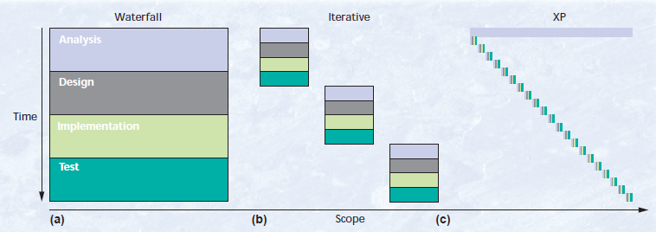
Extreme Programming (XP)
Waterfall Model has long development cycles
Iterative approach (Spiral Model) has shorter development cycles
Extreme Programming (XP) break down into even smaller activities
Rather than planning, analyzing, and designing for the future, do all these tasks in small amounts throughout software development

Slide 3
History/Roots of XP
Strict split between business and technical decision making: Architect Christopher Alexander – The Timeless Way of Building
Rapid evolution of a plan: Scrum methodology and Ward Cunningham’s Episodes pattern language
Emphasis on specifying and scheduling projects by feature: Ivar Jacobson’s work on use cases
Evolutionary delivery: Tom Gilb’s writings on EVO, getting software into production in weeks and then worry about growth
Initial break from waterfall: Barry Boehm’s Spiral Model
Exploiting powerful technology with JIT method: Dave Thomas and colleagues at Object Technology International
Use of metaphors: George Lakoff and Mark Johnson’s books (Philosophy in the Flesh) and Richard Coyne who links metaphor with software development in a postmodern philosophy
Office space: Jim Coplien, Tom DeMarco, and Jim Lister’s ideas on the importance of physical environment for programmers
Notes:
Evolution

Slide 4
XP Practices (1 of 3)
Planning game
Customers decide on scope and timing of releases based on programmers estimates
Programmers only implement the functionality necessary for the stories in this iteration
Small releases
System is put into production before the whole problem is solved (a few months)
New releases are made often (daily to monthly)
Metaphor
Shape of the system shared between the customer and programmers
Simple design
At any moment:
All tests can/are run
No duplicate code
Fewest possible classes and methods
Notes:
“Say everything once and only once”

Slide 5
XP Practices (2 of 3)
Tests
Unit tests are written by programmers minute by minute
Customer write functional tests for iteration stories
All tests are run collectively
Must run correctly Refactoring
System design is evolving as existing design is transformed
Keep all tests running (stipulation for practicality)
Pair programming
All production code is written by two people at one workstation (screen/keyboard/mouse)
Continuous Integration
New code is integrated with current system within a few hours
System is built from scratch and all tests must pass
Notes:
Tests: *comparison of shipping a known defect versus delay cost may come into play
CI: if tests do not pass all changes are discarded

Slide 6
XP Practices (3 of 3)
Collective ownership
Every programmer can/does improve any code in the system at any time
On-site customer
Customer sits with the team full-time
40-hour weeks
Isolated overtime use
No working a two weeks of overtime in a row
Open workspace
Large room with small cubicles around the outside
Pair programming computers in the center
Just rules
Following XP means following the rules
Rules change be changed to meet the needs of the team
Notes:
40-hour week:
Too frequent overtime use is a sign of deeper problems and must be addressed
Just rules:
although the importance of following the strict rules is stressed
as long as the team agrees on how they will assess the effect of the change

Slide 7
Anatomy of XP – XP Development Cycle
Customer determines a release by choosing the most valuable features of all the remaining stories
Looks at cost and speed based on already implemented stories
Customer determines an iteration by choosing from stories remaining in the release
Again looking at cost and speed
Programmers break down stories into tasks
Accepts responsibility
Programmers turn tasks into a set of test cases
Tests will demonstrate the task is complete
Programmers work in pairs to make test cases run
System is evolved to maintain simplest design

Slide 8
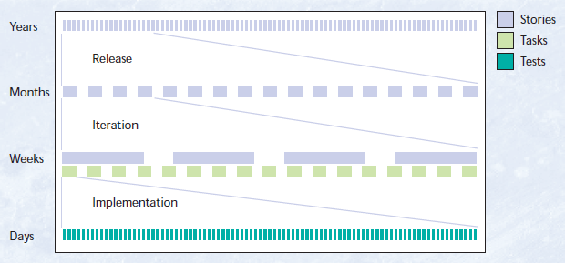
Anatomy of XP – XP Development Cycle (cont.)

Slide 9
Anatomy of XP – Stories
Overall analysis is put together in terms of stories
First decisions should be about what it could do and what it should do
Each story much be business-oriented, testable, and able to be estimated
Rule of thumb: A story should contain the amount of a use case that can fit on an index card
Complete as quickly as possible
Do not worry about exploring all possible issues thoroughly
10 person-year project should only take a month to determine the stories

Slide 10
Anatomy of XP – Release
Smallest set of most valuable stories as chosen by the customer
Customer should think about:
Priorities
Cost
Budget
Two main ways to choose stories for a release:
Customer picks a set of stories and has the programmers calculate the finish date
Pick a date, have the programmers calculate the budget, and then choose stories

Slide 11
Anatomy of XP – Iteration
Customer picks the most valuable stories from those remaining in the release
Team breaks down stories into individual tasks
Can be completed in a few days
Programmers assign themselves to the tasks they want to be responsible for completing
Programmer responsible for the task generates an estimate
Once all estimates are complete, rebalance the load among programmers if necessary
Programmers implement their tasks, integrating their code and tests with the current system
If tests do not run, the code is not integrated into the system
While the team implements their tasks, the customer specifies functional tests
Notes:
Goal of each iteration is to put new tested stories into production

Slide 12
Anatomy of XP – Task
Programmer responsible for the task finds a partner
All production code is written with two people at one machine
Questions about scope or implementation approach result in a short meeting with the customer and/or programmers most familiar/knowledgeable about the code to be touched in implementation
Partners condense list of test cases and prioritize by confidence in completion and what is to be learned about the task
Test case is coded first before any code is touched
If the test case doesn’t run and:
There is a clean way to make it run, refactor to make it run cleanly
There is an ugly way to make it run, but also a clean way that requires re-design, refactor to make it run cleanly
There is an ugly way to make it run and no clean way, make it run the ugly way
After test cases are complete and run, if the system can be made cleaner/simpler, refactor to do so
Note any additional test cases or bigger refactoring needed, but continue on plan
Goal is to remain focused on current task, but not lose the insights

Slide 13
Anatomy of XP – Test
Two twists on conventional unit testing:
Programmers write their own test cases
Programmers write the tests before they code
Addresses accepted wisdom that a programmer cannot effectively test their own code by writing code in pairs
Tests are permanently recorded and automatically run from that point onward
Programmers/team gain confidence in system behavior
Customer created tests are converted into system-wide tests either by the customer or programmer
Customer gains confidence the system operates correctly
Notes:
Unit testing is a key component of XP

Slide 14
Common Failures
Underestimation
First try to solve the problem internally
Do not be afraid to ask the customer for relief
Uncooperative Customers
Explain or demonstrate consequences to the customer
Completing iterations will gain their trust
Turnover
Two people are involved in every code change
New people are paired with more experienced people until ready to accept responsibility for their own tasks
Changing Requirements
By designing for today, equally prepared for any direction taken in the future

Slide 15
Testaments to Success
Working toward a Common Goal (Jim Hannula, Acxiom)
Team: managers, business analysts, developers, testers, and technical writers
Application: Campaign management database
Time: 3 years
Takeaways: Set developer/team expectations; All team members must buy into the approach or it does not work; Decide the direction and stand behind the hard decisions
The Best Team in the World (Chet Hendrickson, DaimlerChrysler)
Team: 10 programmers, 15 total staff
Application: Large-scale payroll system
Time: 4 years
Takeaways: After 33 weeks the system was well factored and backed up by comprehensive set of unit tests giving the customer confidence it was ready to begin performance tuning and parallel testing; Since the launch, new features and enhancements have been added with ease

Slide 16
Testaments to Success (cont.)
A Unique Combination of Agility and Quality (Don Wells, Ford Motor)
Team: 12 programmers, 17 total staff
Application: Cost analysis system
Time: 6 years
Takeaways: Implemented XP a piece at a time to familiarize developers with process; After one year, automated testing covered 40% of the codebase and there was a 40% drop in bug reports; After a year and a half customers and managers noticed far greater system stability
Tariff System: Tests You Can Read (Rob Mee, Independent Consultant)
Team: 3 developers
Application: Shipping tariff calculation system
Time: 3 months
Takeaways: Resolved to adhere to core XP practices of pair programming, simplest design possible, refactor aggressively, and write extensive unit tests; Writing test cases ahead helped bring designs into focus, enabling work to be complete faster; Determined a project role was necessary, a dedicated person to interact with the users

Slide 17
Questions?/Comments

